Slide 1

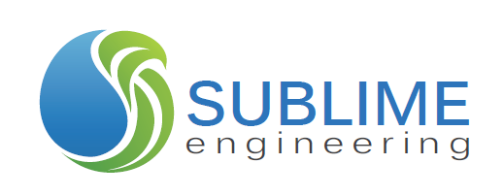
WATER FILTRATION DEVICE FOR URANIUM, ARSENIC, &
BACTERIA REMOVAL
CHERYL DILKS
TRISTAN WEIR
YUJIE SUN
DANIEL CUMMINGS
Final Presentation
April 25, 2014

Slide 2
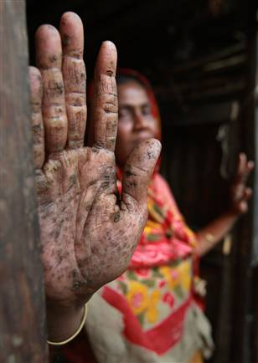
If You Drink Water Contaminated With:
Uranium → Increased cancer risk and kidney toxicity
Arsenic → Skin diseases such as keratosis, increased cancer risk
Bacteria → Acute and/or chronic diarrhea
Photo Source: http://blogs.democratandchronicle.com/520/?p=826

Slide 3
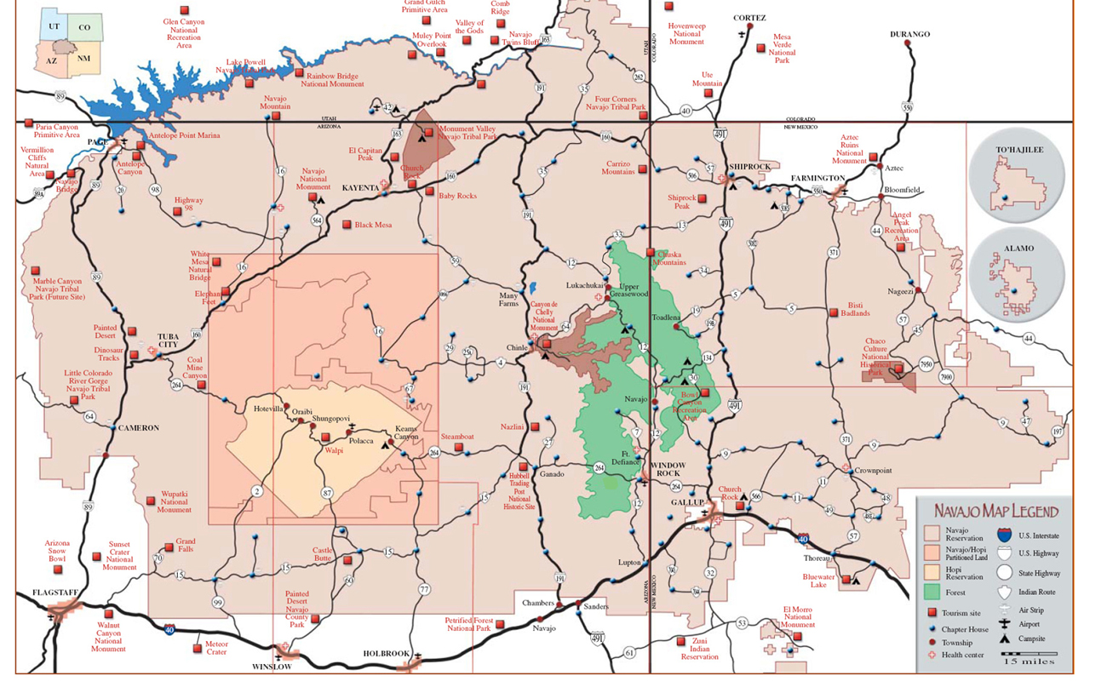
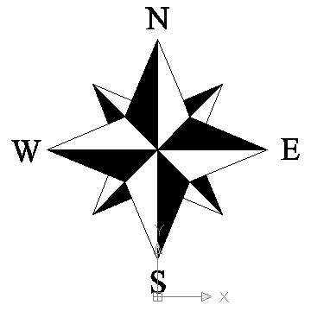
Project Location
Map Source: http://discovernavajo.com/images/Navajomap.jpg

Slide 4
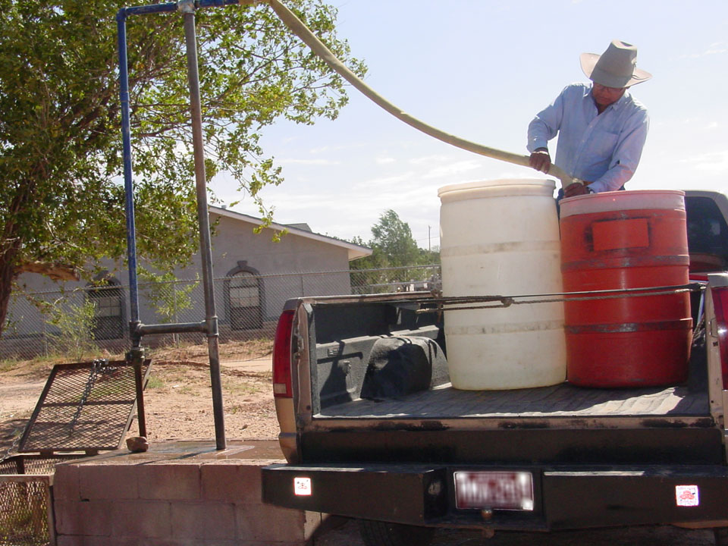
Project Background
Bennett Freeze Area
  43 year-long freeze on infrastructure development
  72.8% of residents have no regulated water
Well Contamination:
  Naturally occurring uranium and abandoned uranium mines
  Naturally occurring arsenic
  Bacteria
Photo Source: http://www.epa.gov/region9/superfund/navajo-nation/contaminated-water.html
Data Sources: Ingram, J. C. (2011). Characterization of Chelating Agents in Non-regulated Water Sources on Navajo Lands. Flagstaff: Northern Arizona University.
Northwestern University Chemistry Department. (Unknown). Navajo Nation Water Quality Project. Retrieved from Navajo Water: http://navajowater.org/

Slide 5
Project Purpose
Design a low-cost, electricity-free water filtration unit
Reduce uranium, arsenic, and coliforms (bacteria)
Contaminant | Uranium | Arsenic | Total Coliforms
Maximum Contaminant Limit | 30 µg/L | 10 µg/L | No more than one sample can be total coliform-positive per month
USEPA Source: http://water.epa.gov/drink/contaminants/index.cfm
Notes:
In order to provide safe drinking water to the residents of the former Bennett Freeze Area (BFA) of the Navajo Nation.
This project serves the residents of the former BFA and the project client, Forgotten People, which is a non-profit organization that advocates for the well-being of the residents of the former BFA by coordinating with other organizations interested in infrastructure development projects within the region.

Slide 6
Design Exclusions/Limitations
This project does not include:
Determination of reaction kinetics for each material
Maintenance/Replacement requirements
Field testing
Bacteria testing
Design or construction of full-scale water filtration unit for implementation

Slide 7
Design Constraints and Requirements
Constraints
Requirements
The device must:
Function as a point-of-use device
Operate without electricity
The device must:
Reduce uranium and arsenic to concentrations below their MCLs
  Less than 30 µg/L for uranium
  Less than 10 µg/L for arsenic
Produce bacteria-free water

Slide 8
Approach
Selection of Water Quality Tests
Identification of Testing Facilities
Synthetic Water Creation
Evaluation of Existing Technologies
Identification of Alternatives
Column Testing of Alternatives
Testing of Modular Configurations
Final Recommendations

Slide 9
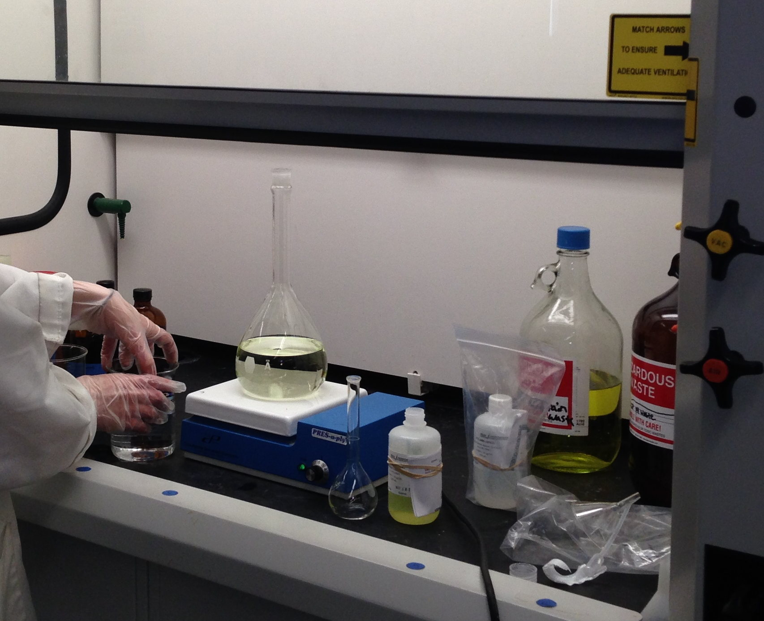
Synthetic Water Development
 | pH | U (µg/L) | As (µg/L) | Coliforms (CFU/100 mL)
Synthetic Water Goals | 7.8-8.4 | 100 | 70 | Less than 100
Actual Synthetic Water | 7.72 | 84.71 | 68.65 | 2
Determination of ratio of groundwater to surface water
Blending of groundwater and surface water
Creation of uranium and arsenic standards
Spiking with uranium and arsenic standards

Slide 10
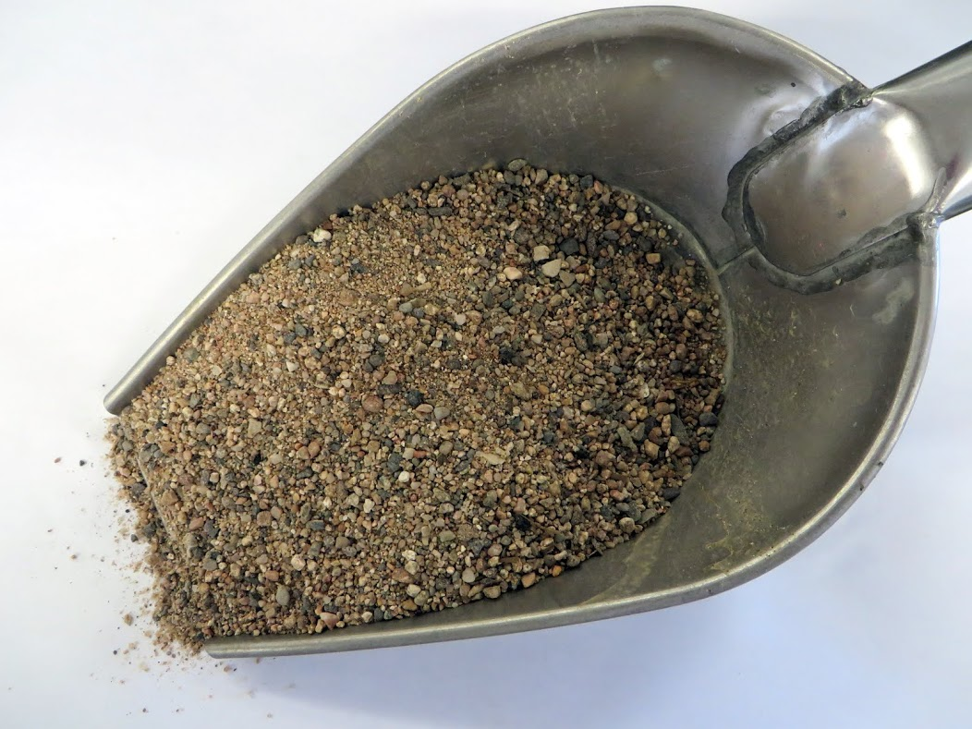
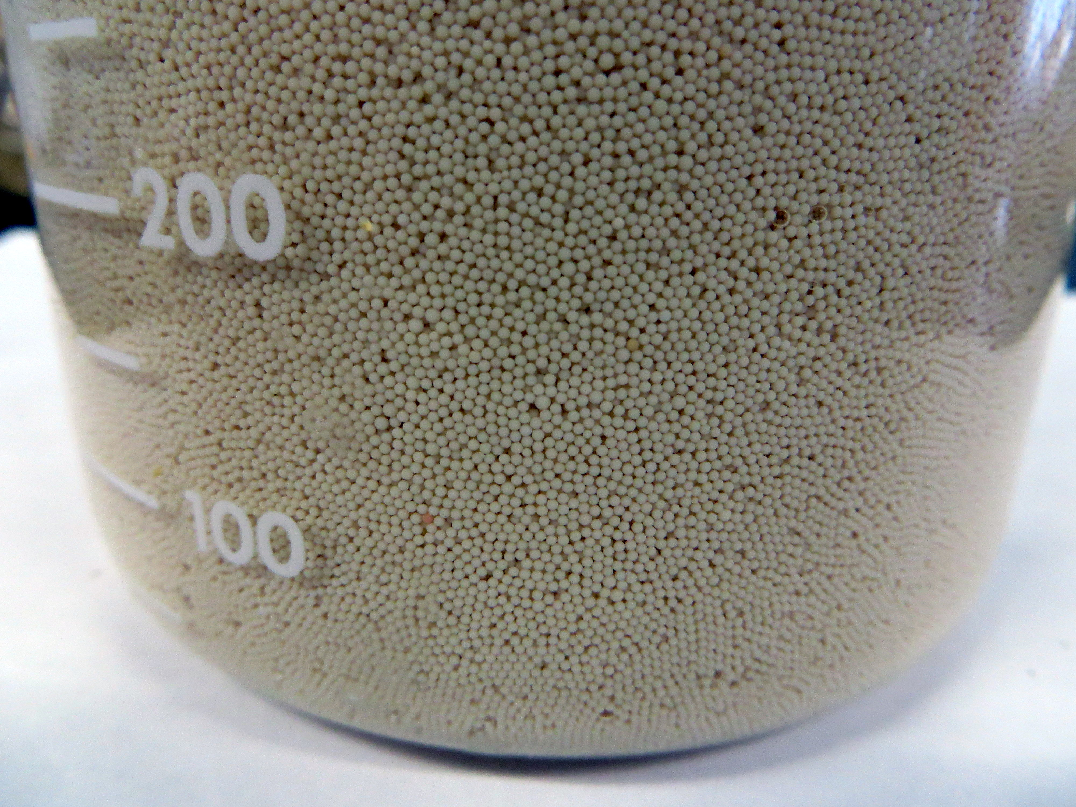
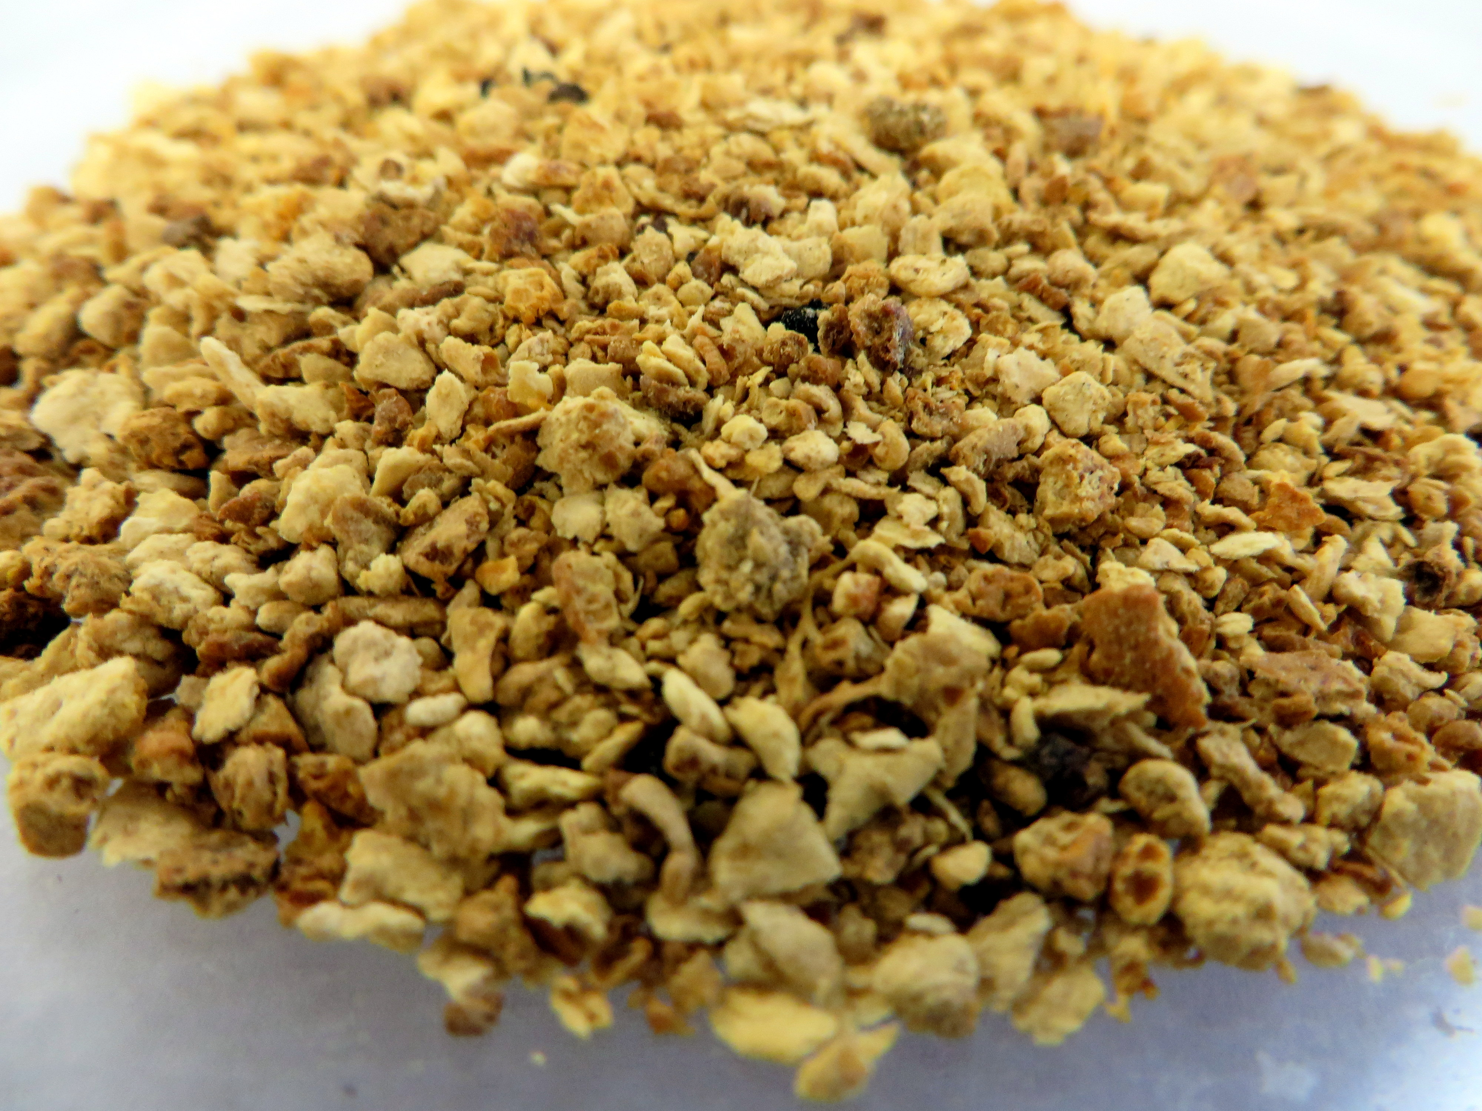
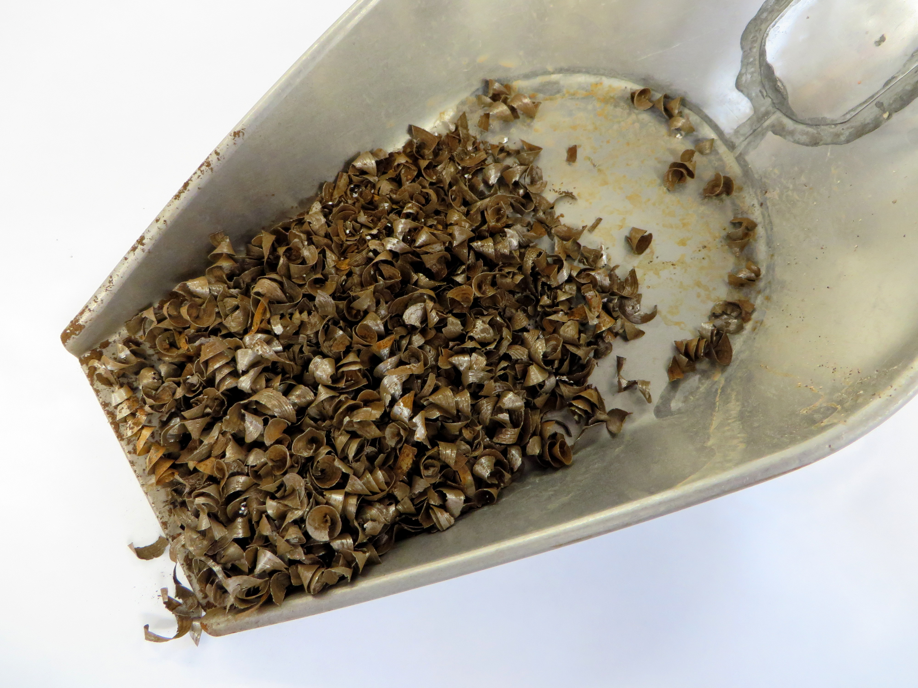
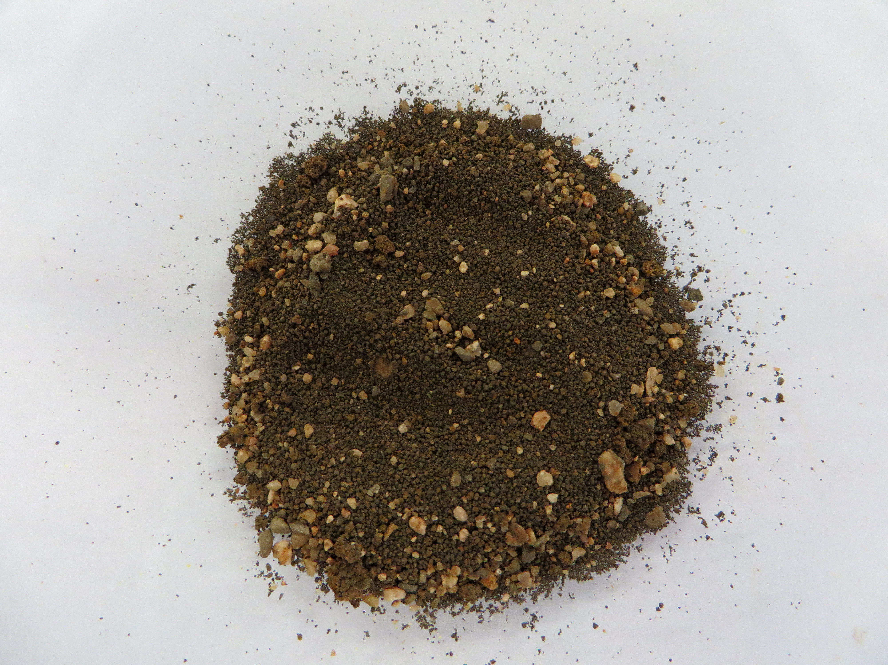
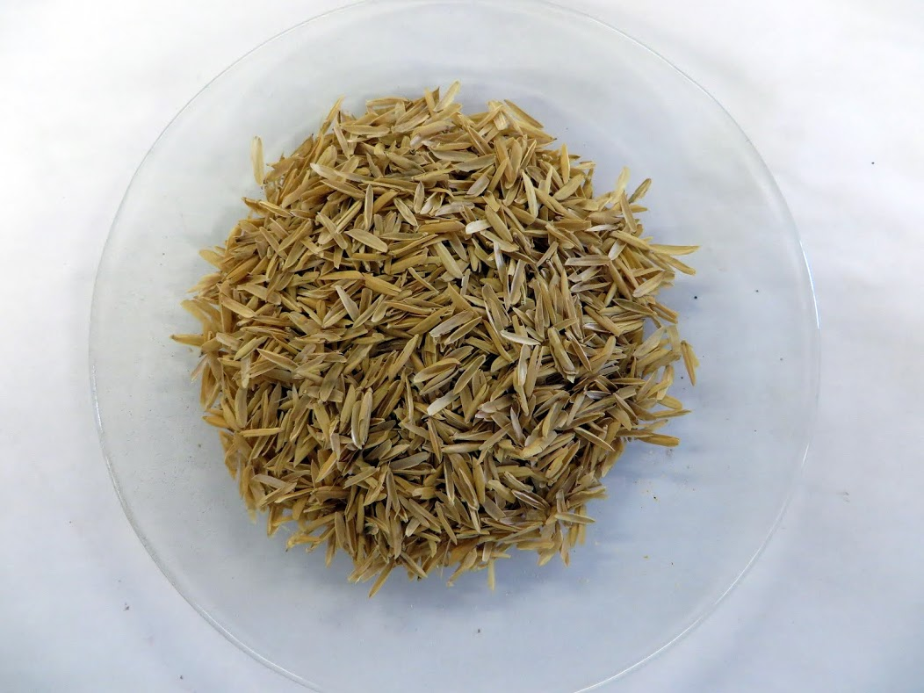
Alternatives
Sand
Selected as a control
Ion Exchange Resin
Uranium removal
Highly designed material
Minimal likelihood for failure
Orange Peels
Uranium removal
Low-cost
Low-tech
Organic, renewable material
Zero Valent Iron Turnings
Arsenic removal
Low-tech
Low-cost (free waste product)
Zero Valent Iron Filings
Arsenic removal
Low-tech
Low-cost
Small particle size, larger surface area
Rice Husks
Arsenic removal
Low-tech
Low-cost (waste product of rice milling)

Slide 11
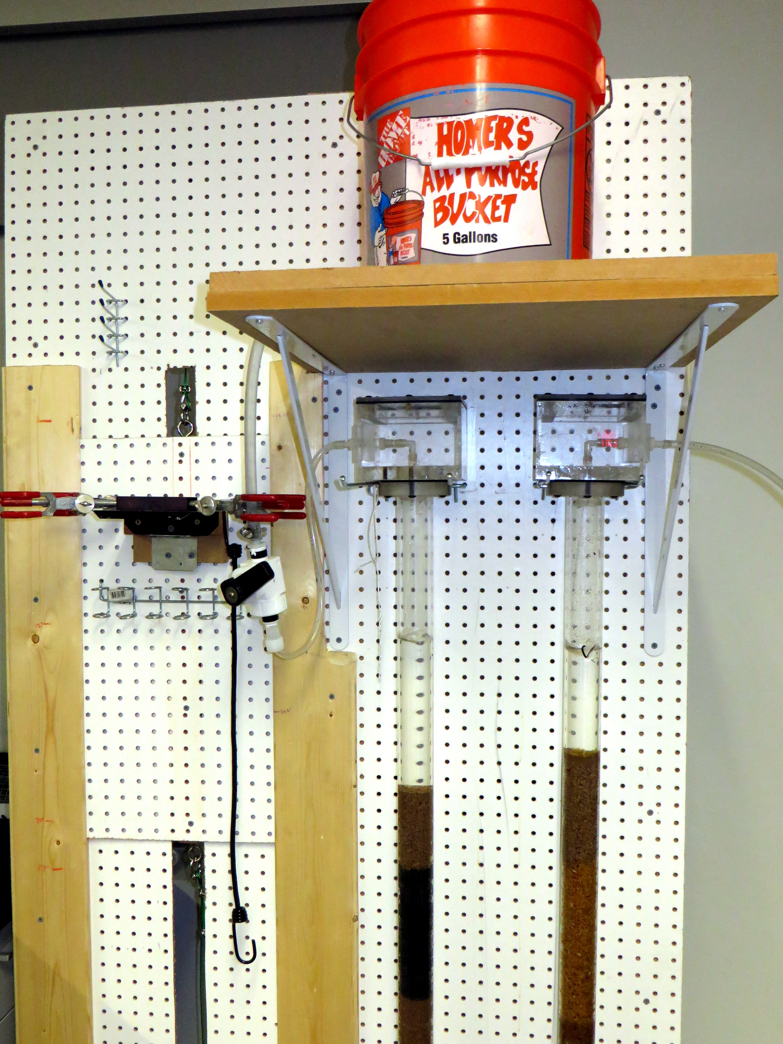
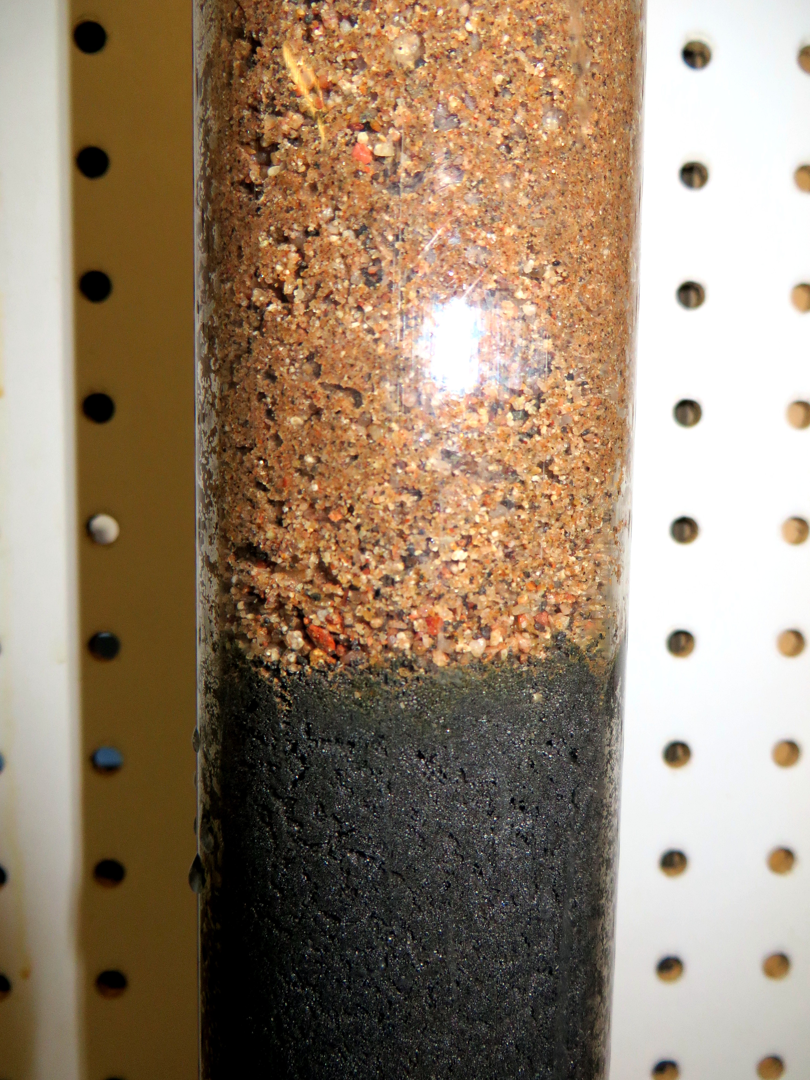
Column Testing
Each material tested with 7 L of synthetic water
4 effluent samples at volumes of 1 L, 3 L, 5 L, and 7 L

Slide 12
SAND
Sand
 |  |  | Filtered Water Volume (L)
 | USEPA Standards | Synthetic Water | 1 | 3 | 5 | 7
Uranium Concentration (µg/L) | 30 | 84.71 | 77.65 | 77.64 | 84.13 | 81.43
Uranium Removal Efficiency | N/A | N/A | 8.33% | 8.35% | 0.68% | 3.87%
Arsenic Concentration (µg/L) | 10 | 68.65 | 38.28 | 47.12 | 53.12 | 55.48
Arsenic Removal Efficiency | N/A | N/A | 44.24% | 31.36% | 22.62% | 19.18%

Slide 13
Ion Exchange Resin
 |  |  | Filtered Water Volume (L)
 | USEPA Standards | Synthetic Water | 1 | 3 | 5 | 7
Uranium Concentration (µg/L) | 30 | 84.71 | 0.13 | 0.09 | 0.09 | 0.09
Uranium Removal Efficiency | N/A | N/A | 99.85% | 99.89% | 99.89% | 99.89%
Arsenic Concentration (µg/L) | 10 | 68.65 | 2.27 | 1.90 | 1.84 | 1.86
Arsenic Removal Efficiency | N/A | N/A | 96.69% | 97.23% | 97.32% | 97.29%
Ion Exchange Resin

Slide 14
Orange Peels
 |  |  | Filtered Water Volume (L)
 | USEPA Standards | Synthetic Water | 1 | 3 | 5 | 7
Uranium Concentration (µg/L) | 30 | 84.71 | 0.82 | 0.52 | 0.57 | 0.52
Uranium Removal Efficiency | N/A | N/A | 99.03% | 99.39% | 99.33% | 99.39%
Arsenic Concentration (µg/L) | 10 | 68.65 | 26.07 | 48.31 | 46.35 | 49.82
Arsenic Removal Efficiency | N/A | N/A | 62.02% | 29.63% | 32.48% | 27.43%
Orange Peels

Slide 15
Zero Valent Iron Turnings
 |  |  | Filtered Water Volume (L)
 | USEPA Standards | Synthetic Water | 1 | 3 | 5 | 7
Uranium Concentration (µg/L) | 30 | 84.71 | 27.91 | 49.64 | 70.92 | 41.69
Uranium Removal Efficiency | N/A | N/A | 67.05% | 41.40% | 16.28% | 50.79%
Arsenic Concentration (µg/L) | 10 | 68.65 | 6.26 | 4.76 | 5.60 | 6.84
Arsenic Removal Efficiency | N/A | N/A | 90.88% | 93.07% | 91.84% | 90.04%
Zero Valent Iron Turnings

Slide 16
Zero Valent Iron Filings
 |  |  | Filtered Water Volume (L)
 | USEPA Standards | Synthetic Water | 1 | 3 | 5 | 7
Uranium Concentration (µg/L) | 30 | 84.71 | 0.11 | 0.15 | 0.14 | 0.12
Uranium Removal Efficiency | N/A | N/A | 99.87% | 99.82% | 99.83% | 99.86%
Arsenic Concentration (µg/L) | 10 | 68.65 | 7.92 | 2.29 | 1.29 | 0.79
Arsenic Removal Efficiency | N/A | N/A | 88.46% | 96.66% | 98.12% | 98.85%
Zero Valent Iron Filings

Slide 17
Rice Husks
 |  |  | Filtered Water Volume (L)
 | USEPA Standards | Synthetic Water | 1 | 3 | 5 | 7
Uranium Concentration (µg/L) | 30 | 84.71 | 0.77 | 1.38 | 7.89 | 67.41
Uranium Removal Efficiency | N/A | N/A | 99.09% | 98.37% | 90.69% | 20.42%
Arsenic Concentration (µg/L) | 10 | 68.65 | 29.63 | 51.48 | 56.36 | 61.02
Arsenic Removal Efficiency | N/A | N/A | 56.84% | 25.01% | 17.90% | 11.11%
Rice Husks

Slide 18
Comparison of all Materials
 |  |  | Filtered Water Volume (L)
Contaminant and USEPA Standard | Synthetic Water |  | 1 | 3 | 5 | 7
Uranium, 30 µg/L | 84.71 µg/L | Sand | 77.65 | 77.64 | 84.13 | 81.43
 |  | Ion Exchange Resin | 0.13 | 0.09 | 0.09 | 0.09
 |  | Orange Peels | 0.82 | 0.52 | 0.57 | 0.52
 |  | ZVI Turnings | 27.91 | 49.64 | 70.92 | 41.69
 |  | ZVI Filings | 0.11 | 0.15 | 0.14 | 0.12
 |  | Rice Husks | 0.77 | 1.38 | 7.89 | 67.41
Arsenic, 10 µg/L | 68.65 µg/L | Sand | 38.28 | 47.12 | 53.12 | 55.48
 |  | Ion Exchange Resin | 2.27 | 1.90 | 1.84 | 1.86
 |  | Orange Peels | 26.07 | 48.31 | 46.35 | 49.82
 |  | ZVI Turnings | 6.26 | 4.76 | 5.60 | 6.84
 |  | ZVI Filings | 7.92 | 2.29 | 1.29 | 0.79
 |  | Rice Husks | 29.63 | 51.48 | 56.36 | 61.02

Slide 19
Comparison of Results
Filter Material | Uranium Removal | Arsenic Removal
Sand | NO | NO
Ion Exchange Resin | YES | YES
Orange Peels | YES | NO
ZVI Turnings | NO | YES
ZVI Filings | YES | YES
Rice Husks | NO | NO

Slide 20
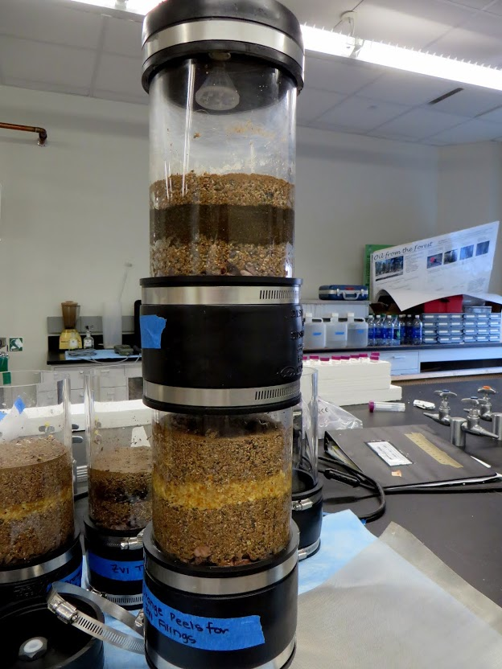
Modular Configuration Testing and Results
Comparison of all Configurations
 |  |  | Filtered Water Volume (L)
Contaminant and USEPA Standard | Synthetic Water |  | 2.5 | 5 | 7.5 | 10
Uranium, 30 µg/L | 84.71 µg/L | Configuration #1: ZVI Filings, Orange Peels | 0.32 | 6.12 | 27.32 | 41.23
 |  | Configuration #2: Orange Peels, ZVI Filings | 7.83 | 4.16 | 3.14 | 2.80
 |  | Configuration #3: Orange Peels, ZVI Turnings | 20.17 | 47.42 | 50.85 | 67.13
 |  | Configuration #4: ZVI Turnings, Orange Peels | 57.11 | 59.34 | 72.35 | 73.63
Arsenic, 10 µg/L | 68.65 µg/L | Configuration #1: ZVI Filings, Orange Peels | 8.13 | 8.69 | 19.81 | 21.51
 |  | Configuration #2: Orange Peels, ZVI Filings | 6.53 | 2.93 | 2.14 | 2.27
 |  | Configuration #3: Orange Peels, ZVI Turnings | 7.36 | 10.84 | 12.08 | 14.98
 |  | Configuration #4: ZVI Turnings, Orange Peels | 21.83 | 17.69 | 15.58 | 17.88
4 Configurations:
Each configuration tested with 10 L of synthetic water
4 effluent samples at volumes of 2.5 L, 5 L, 7.5 L, and 10 L
#1 | #2 | #3 | #4
ZVI Filings | Orange Peels | Orange Peels | ZVI Turnings
Orange Peels | ZVI Filings | ZVI Turnings | Orange Peels
Notes:
Note: Why no IER?

Slide 21
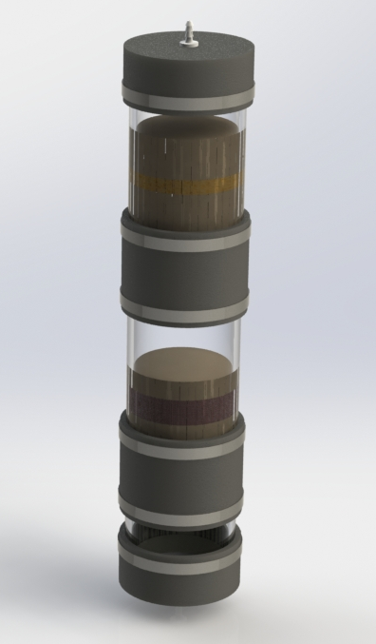
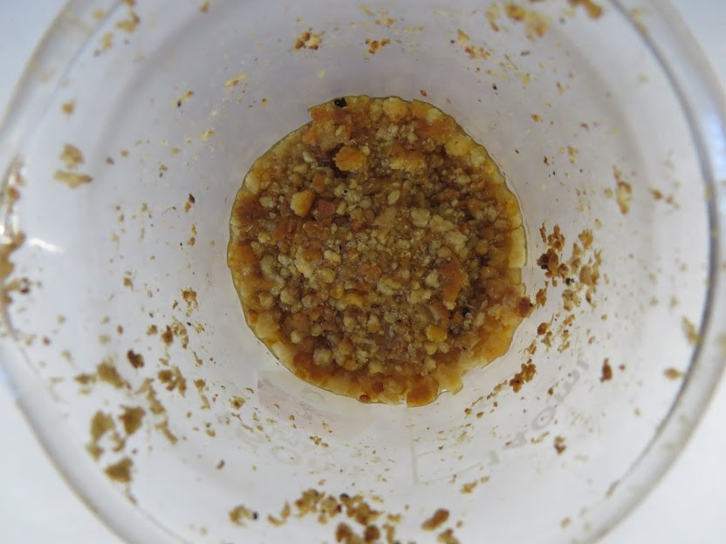
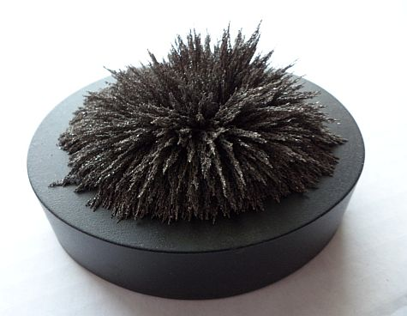
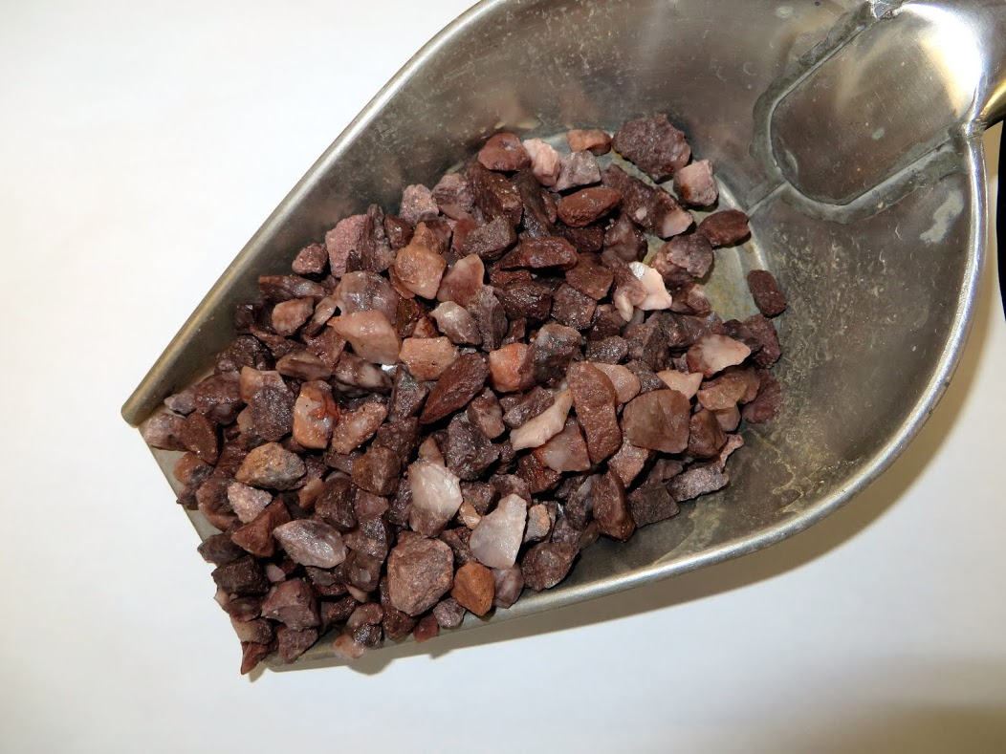
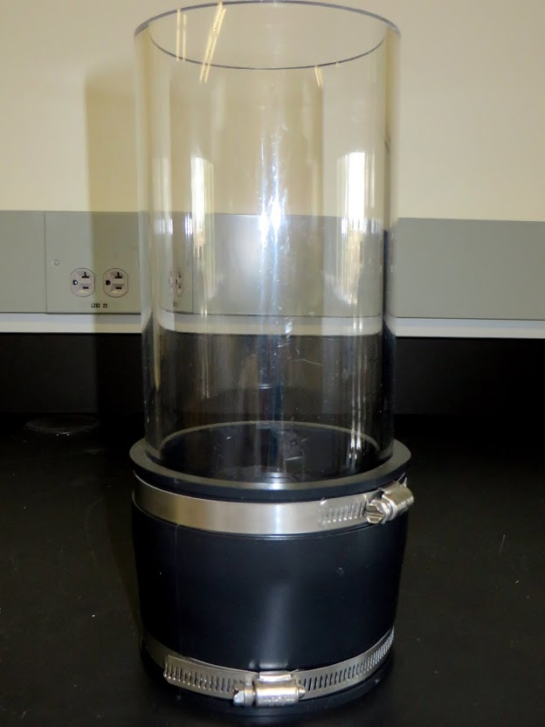
Final Recommendations

Slide 22
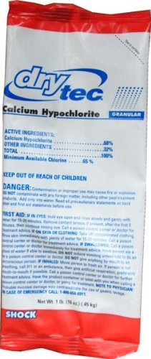
Final Recommendations
#1 Granular Activated Carbon as Polishing Step
#2 Disinfection
  High-test hypochlorite (HTH)
    Create 1% Stock Solution: 1 tablespoon of HTH: 1 L water
    Assuming daily water usage is 37.5 L (5 people, 7.5L/capita), then approx. 4 teaspoons of 1% stock solution is needed per day
    $0.70 per year per family
Chlorine Sources: http://www.amazon.com/Dry-Tec-Hypochlorite-Powdered-Chlorine-Swimming/dp/B00B9HQ2O6 http://www.who.int/water_sanitation_health/publications/2011/9789241548151_ch05.pdf

Slide 23
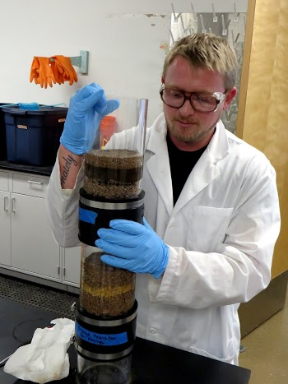
Further Improvements
Reaction kinetics and adsorption capacity
  Optimized material volumes
  Material longevity
Improvements to modular system
Finalized bench-scale device
O&M Manual
Economic Analysis

Slide 24
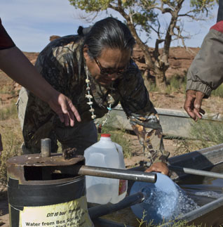
Impacts
Negative contributions to natural environment
Varied contributions to political systems and economies
Sustainability
Positive
contributions to health
  Arsenic
  Uranium
  Bacteria
Photo Sources: http://pavementpieces.com/the-forgotten-navajo-people-in-need/

Slide 25
Total Project Costs
Cost Category | Cost
Travel | $16
Analytical Laboratory Fees + Shipping | $260
Project Materials and Chemicals | $984
Total Costs | $1260

Slide 26
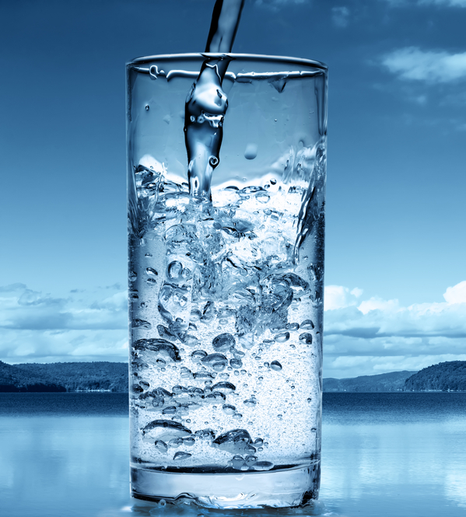
Acknowledgements
Dr. Paul Gremillion, Northern Arizona University
Dr. Michael Ketterer, Metropolitan State College of Denver
Dr. Bridget Bero, Northern Arizona University
Dr. Wilbert Odem, Northern Arizona University
Dr. Terry Baxter, Northern Arizona University
Staff at Lake Mary Water Treatment Plant in Flagstaff, AZ
Emerson Jones, Mechanical Engineering Student, Northern Arizona University
Photo Source: http://originwater-int.com/tag/frac-flowback-water-treatment/
Notes:
The team would like to extend their gratitude to numerous individuals for their time and assistance in completing this project. We thank Dr. Paul Gremillion of NAU for his technological guidance, Dr. Michael Ketterer of Metropolitan State College of Denver for his uranium and arsenic testing and analysis, Dr. Bridget Bero of NAU for providing project guidance, Dr. Wilbert Odem of NAU for donating his well water, Dr. Terry Baxter of NAU for assisting with laboratory needs, and the staff at the Lake Mary Water Treatment Plant in Flagstaff, Arizona for allowing us to use untreated Lake Mary water from their tap.

Slide 27
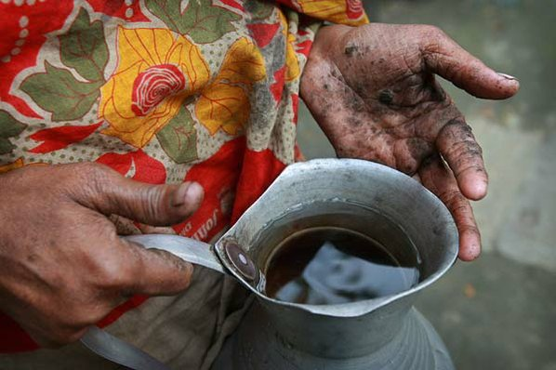
Questions?
Photo Source: http://www.nwaonline.com/news/2010/jun/28/arsenic-killing-bangladeshis-20100628/

Slide 28
References

